Slide 1

Rentlora Cloud Architecture
A modern property and booking platform built for enterprise-grade scalability, security, and performance on AWS.

Slide 2
Platform Overview
Rentlora is built for high availability, elastic scale, and secure service separation across AWS.
Microservices
Multi-AZ
Independent FastAPI services that scale and deploy separately.
Distributed across Availability Zones for resilience.
VPC Isolation
Tiered network controls with strict access boundaries.

Slide 3
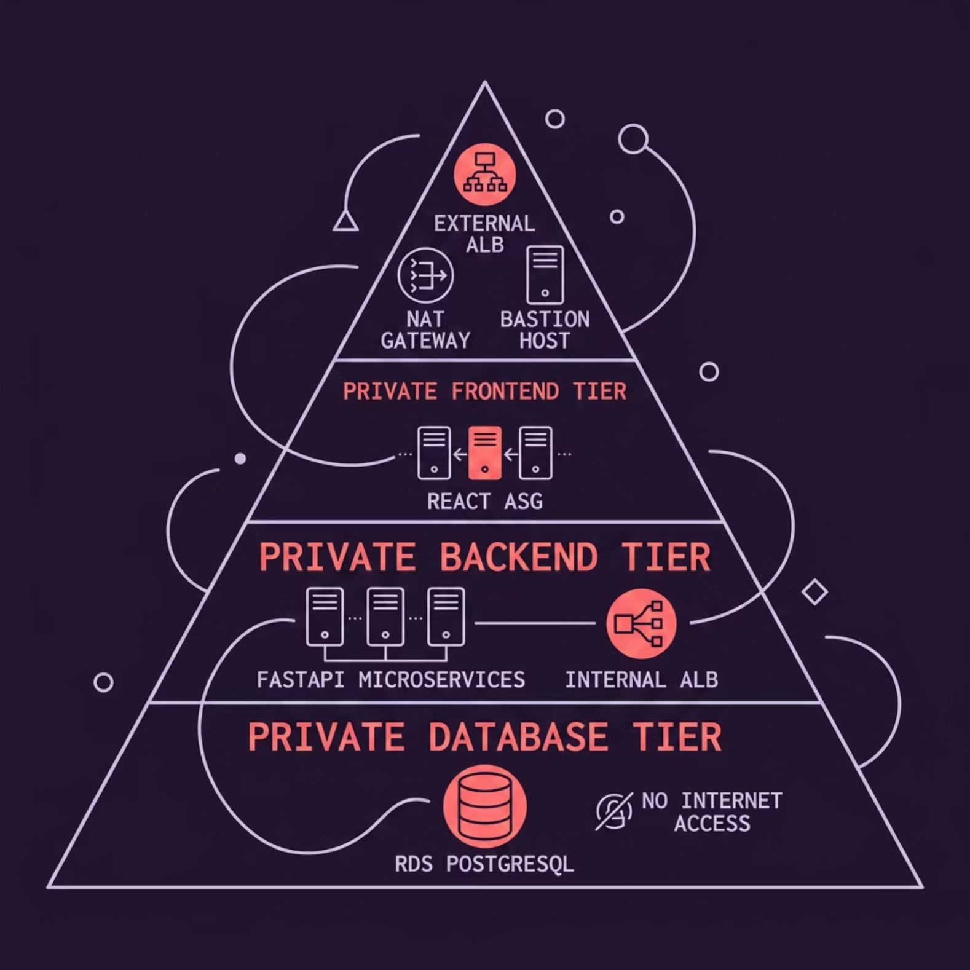

Network Security & VPC Isolation
A custom multi-tier VPC in us-east-1 enforces strict network segmentation across four subnet tiers.
Public Subnet
Private Frontend Tier
External ALB, NAT Gateway, Bastion Host.
React ASG with no direct internet exposure.
Private Backend Tier
Private Database Tier
FastAPI services behind Internal ALB.
RDS PostgreSQL with no public access.

Slide 4
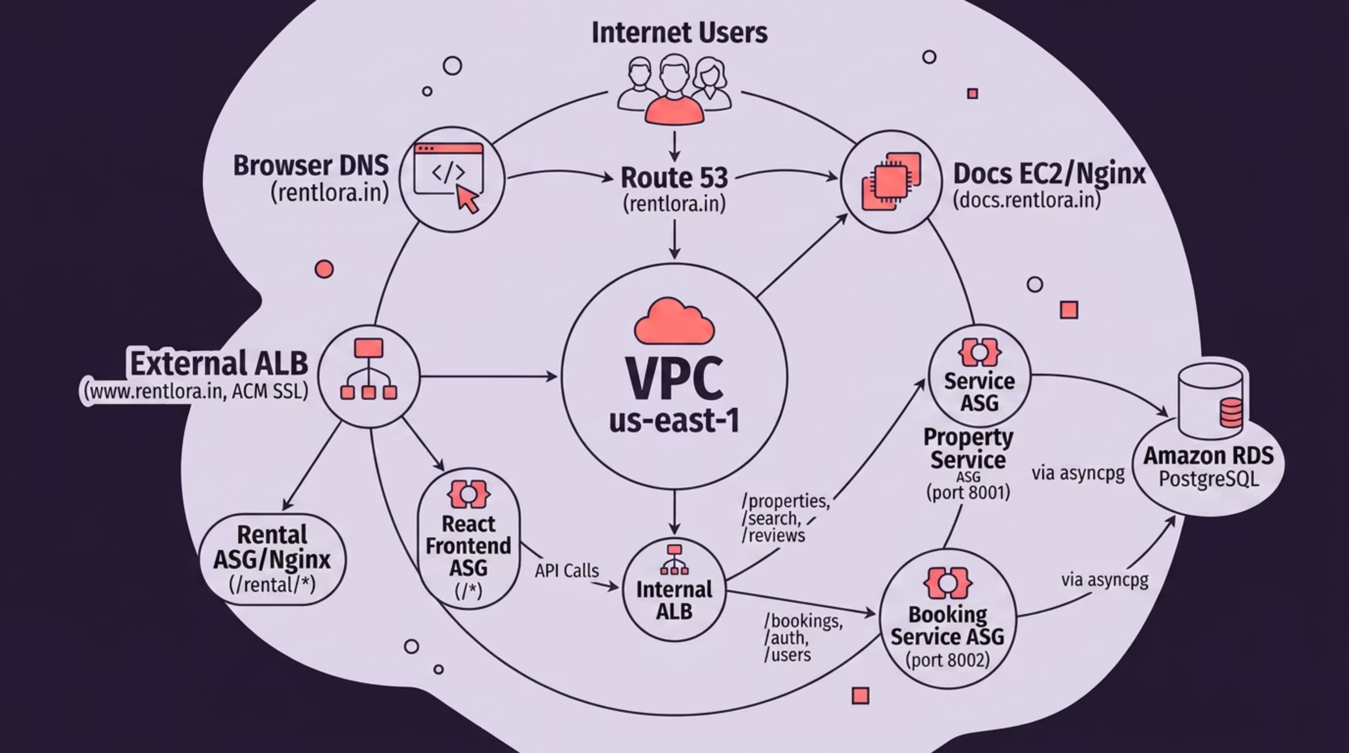

System Architecture
End-to-end request flow from internet users through DNS, ALBs, microservices, and the database layer.

Slide 5
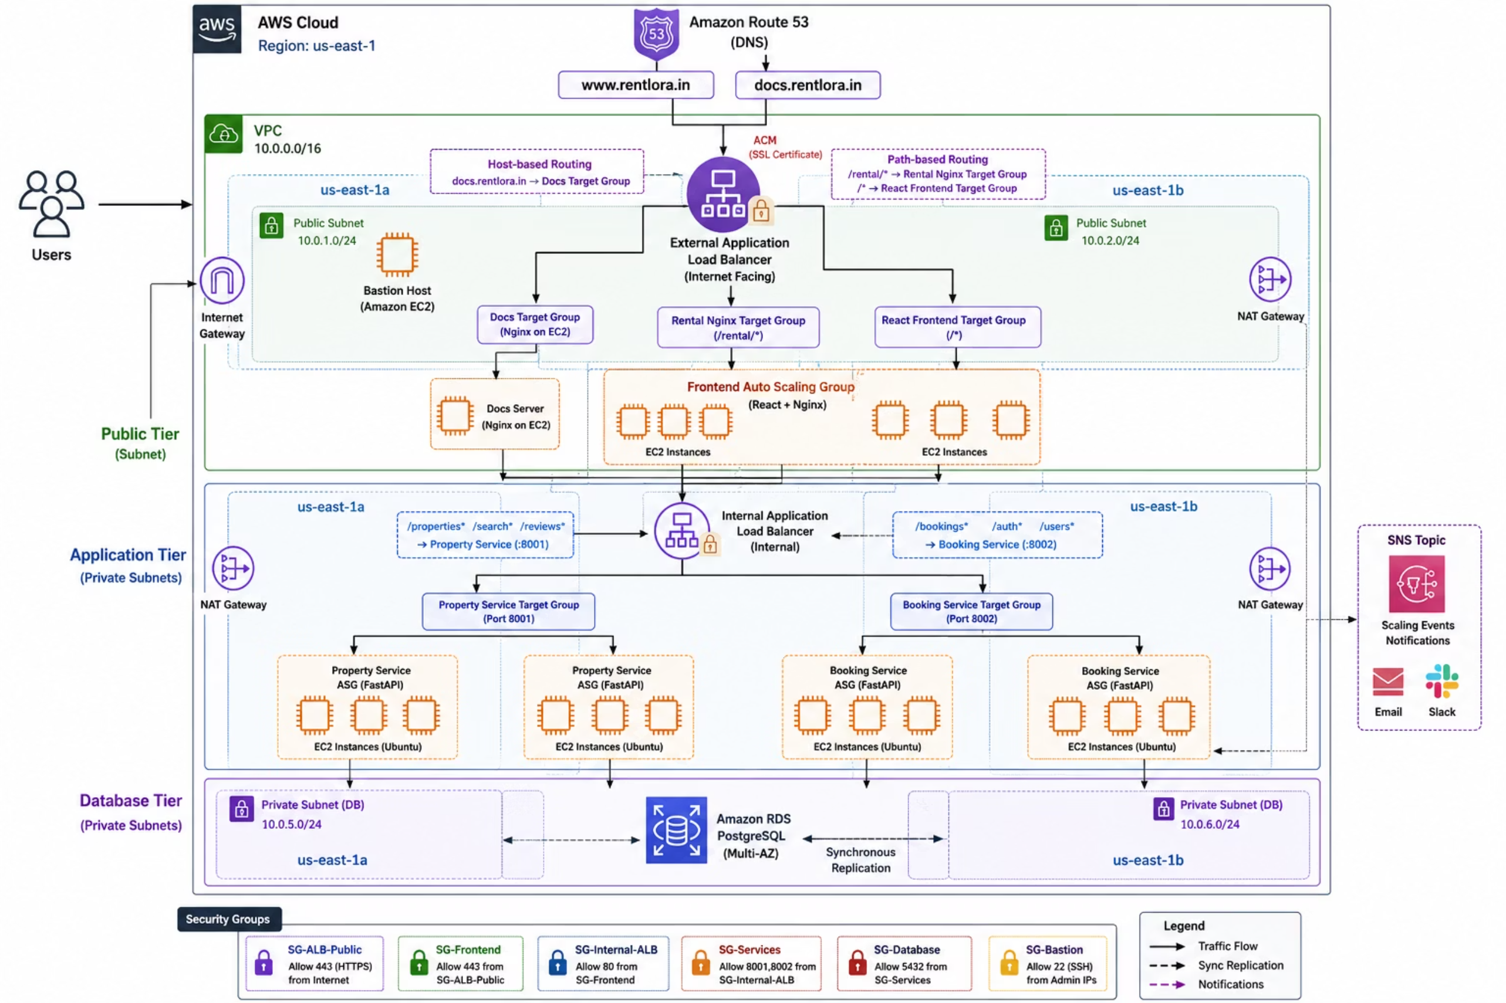

Slide 6

Advanced Traffic Routing — External ALB
The External Application Load Balancer is the platform’s single public entry point.
Host-Based Routing
Path-Based Routing
docs.rentlora.in routes to the Docs EC2/Nginx server.
/rental/* → Nginx marketing cluster. /* → React SPA frontend cluster.

Slide 7
Internal Service Routing — Internal ALB
The Internal ALB acts as a private API gateway, routing frontend requests to backend microservices without exposing them publicly.
Property Service ASG :8001
Booking Service ASG :8002
/properties
/search
/reviews
/bookings
/auth
/users

Slide 8

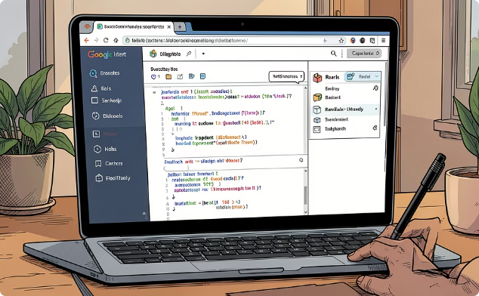

Compute & Persistence Layer
Compute Layer
Frontend Layer
Database Layer
Python 3.12 FastAPI microservices run on Miniconda-backed EC2 Auto Scaling Groups with Nginx for elasticity.
React SPA is served by an Auto Scaling Group behind the External ALB.
Amazon RDS PostgreSQL stays in private subnets with async access via asyncpg.

Slide 9
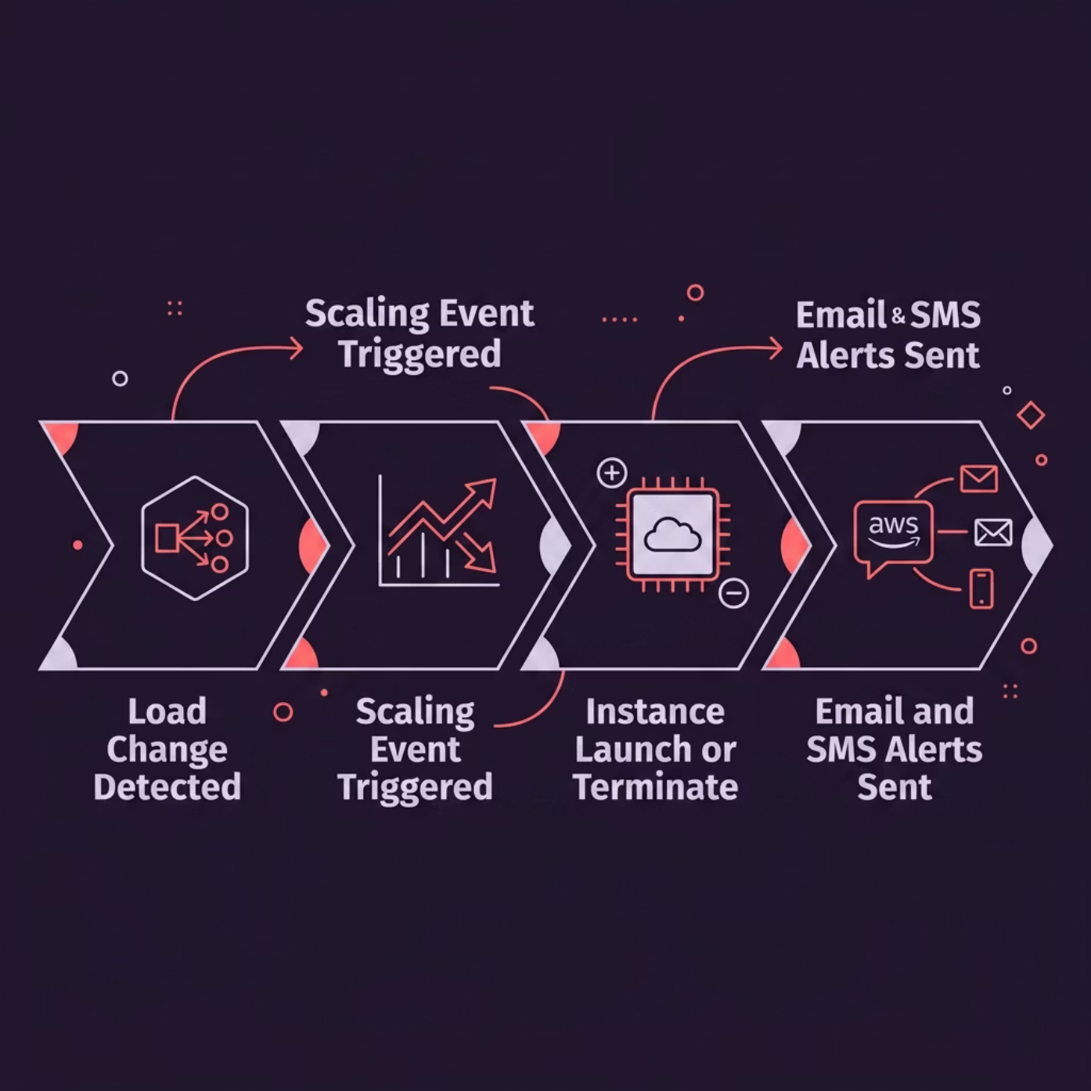

Auto Scaling Alerts & SNS Notifications
AWS SNS is integrated with Auto Scaling Groups to deliver real-time notifications on every scaling event — keeping the DevOps team immediately aware of infrastructure changes.
EC2 Launch Events
EC2 Termination Events
Scale-Out / Scale-In Operations
Alerts triggered when new instances spin up during scale-out.
Notifications on instance termination during scale-in.
Full visibility into capacity changes across all ASGs.

Slide 10
THANK YOU

